Slide 1

Deployment
Wenxuan Shi
College of Software, Nankai University
Email: shiwx@nankai.edu.cn
Wechat: 13920561100

Slide 2
Topics
Build and release an Android app
Build and release an iOS app
Build and release a web app
Continuous delivery with Flutter

Slide 3
Build and release an Android app
Notes:
StatelessWidget is used for immutable elements that only rely on the object configuration information
StatefulWidget is used for elements that can dynamically change based on state-changes in the system
Everytime that state changes, setChange() is called by the object

Slide 4
Introduction
During a typical development cycle, you test an app using flutter run at the command line, or by using the Run and Debug options in your IDE.
By default, Flutter builds a debug version of your app.
Before publishing, you might want to put some finishing touches on your app.

Slide 5
Topics
Adding a launcher icon
Signing the app
R8
Reviewing the app manifest
Reviewing the build configuration
Building the app for release
Publishing to the Google Play Store
Updating the app’s version number
Android release FAQ

Slide 6
Adding a launcher icon
When a new Flutter app is created, it has a default launcher icon.
To customize this icon, you might want to check out the flutter_launcher_icons package.

Slide 7
Alternatively, you can do it manually using the following steps:
Review the Material Design product icons guidelines for icon design.
In the <app dir>/android/app/src/main/res/ directory, place your icon files in folders named using configuration qualifiers. The default mipmap- folders demonstrate the correct naming convention.
In AndroidManifest.xml, update the application tag’s android:icon attribute to reference icons from the previous step (for example, <application android:icon="@mipmap/ic_launcher" ...).
To verify that the icon has been replaced, run your app and inspect the app icon in the Launcher.

Slide 8
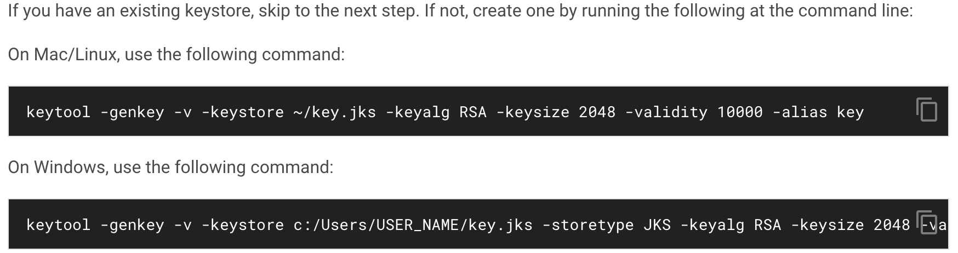
Signing the app
To publish on the Play Store, you need to give your app a digital signature. Use the following instructions to sign your app.
Create a keystore

Slide 9
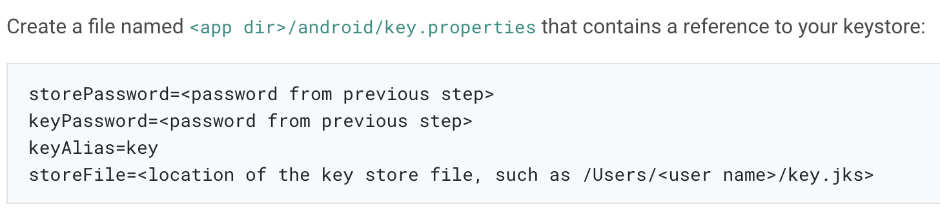
Reference the keystore from the app

Slide 10
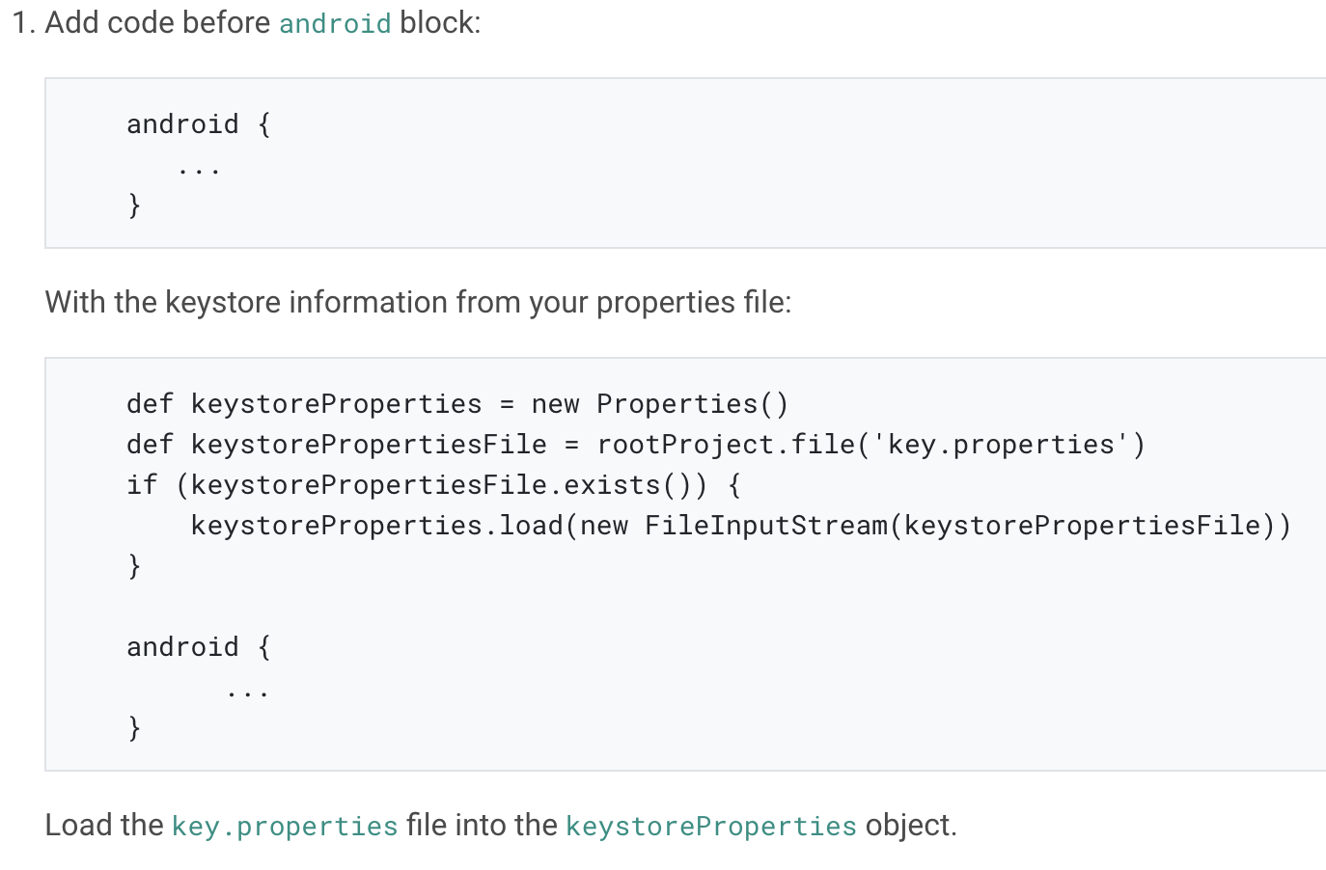
Configure signing in gradle: edit the <app dir>/android/app/build.gradle file.

Slide 11
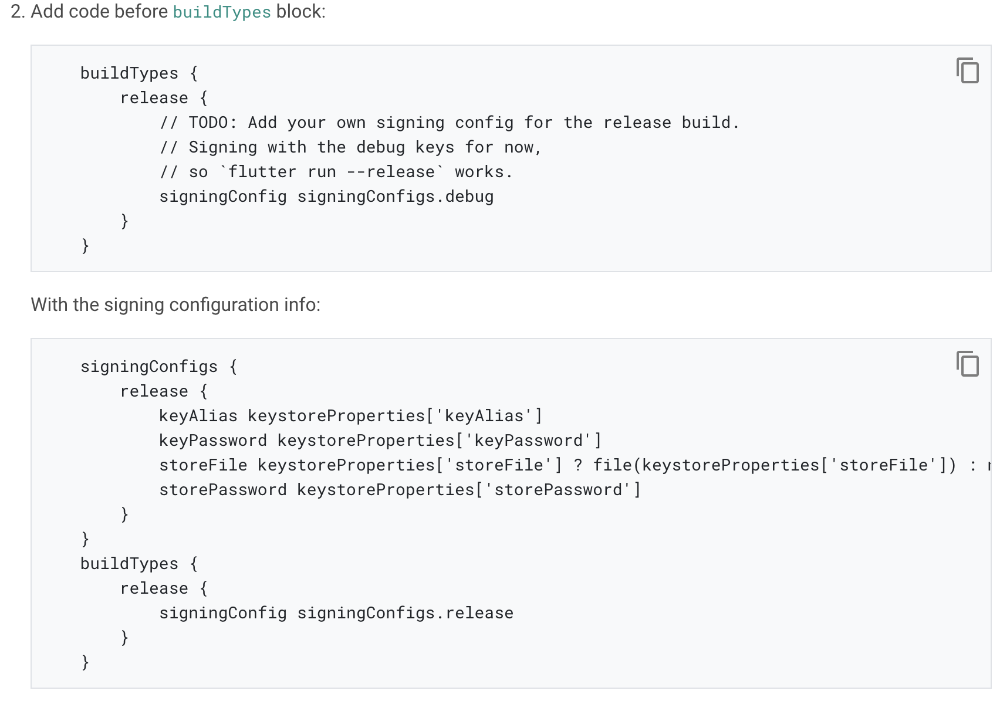

Slide 12
R8
R8 is the new code shrinker from Google, and it’s enabled by default when you build a release APK or AAB.
To disable R8, pass the --no-shrink flag to flutter build apk or flutter build appbundle.
Note: Obfuscation and minification can considerably extend compile time of the Android application.

Slide 13
Reviewing the app manifest
Review the default App Manifest file, AndroidManifest.xml, located in <app dir>/android/app/src/main and verify that the values are correct, especially the following:
Application: Edit the android:label in the application tag to reflect the final name of the app.
uses-permissionAdd the android.permission.INTERNET permission if your application code needs Internet access.

Slide 14
Reviewing the build configuration
Review the default Gradle build file file, build.gradle, located in <app dir>/android/app and verify the values are correct, especially the following values in the defaultConfig block:
applicationId: Specify the final, unique (Application Id)appid
versionCode & versionName: Specify the internal app version number, and the version number display string.
minSdkVersion & targetSdkVersionSpecify the minimum API level, and the API level on which the app is designed to run.

Slide 15
Building the app for release
You have two possible release formats when publishing to the Play Store.
App bundle (preferred)
APK
Note: The Google Play Store prefers the app bundle format. For more information, see Android App Bundle and About Android App Bundles.

Slide 16
Build an app bundle
This section describes how to build a release app bundle. If you completed the signing steps, the app bundle will be signed. At this point, you might consider obfuscating your Dart code to make it more difficult to reverse engineer.
From the command line:
Enter cd <app dir> (Replace <app dir> with your application’s directory.)
Run flutter build appbundle (Running flutter build defaults to a release build.)

Slide 17
Test the app bundle
Offline using the bundle tool
If you haven’t done so already, download bundletool from the GitHub repository.
Generate a set of APKs from your app bundle.
Deploy the APKs to connected devices.
Online using Google Play
Upload your bundle to Google Play to test it. You can use the internal test track, or the alpha or beta channels to test the bundle before releasing it in production.
Follow these steps to upload your bundle to the Play Store.

Slide 18
Build an APK
Although app bundles are preferred over APKs, there are stores that don’t yet support app bundles. In this case, build a release APK for each target ABI (Application Binary Interface).
If you completed the signing steps, the APK will be signed.

Slide 19
From the command line:
Enter cd <app dir> (Replace <app dir> with your application’s directory.)
Run flutter build apk --split-per-abi (The flutter build command defaults to --release.)
This command results in three APK files:
<app dir>/build/app/outputs/apk/release/app-armeabi-v7a-release.apk
<app dir>/build/app/outputs/apk/release/app-arm64-v8a-release.apk
<app dir>/build/app/outputs/apk/release/app-x86_64-release.apk

Slide 20
Install an APK on a device
Follow these steps to install the APK on a connected Android device.
From the command line:
Connect your Android device to your computer with a USB cable.
Enter cd <app dir> where <app dir> is your application directory.
Run flutter install.

Slide 21
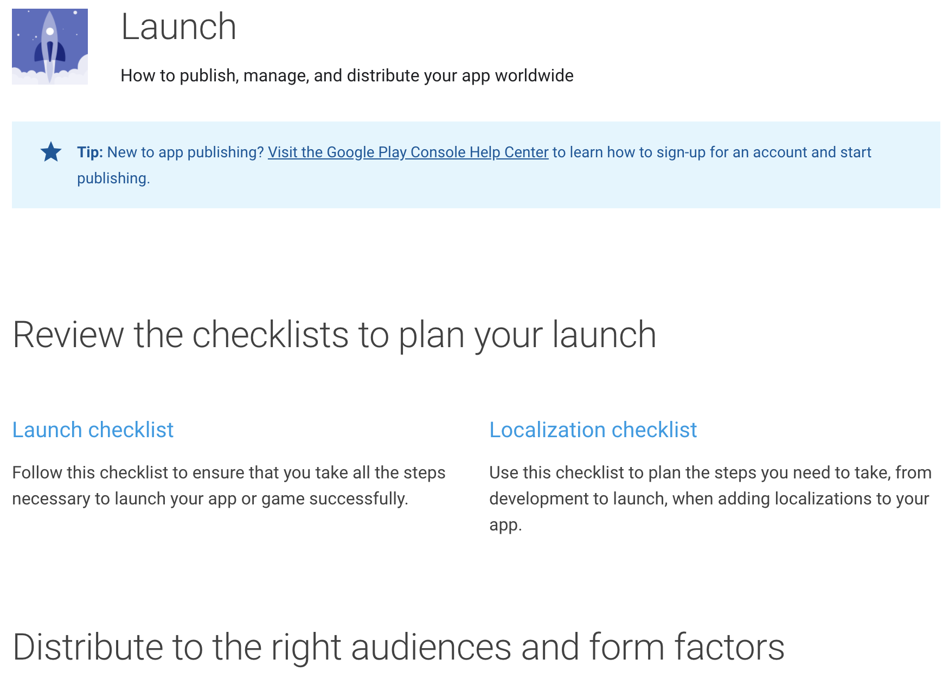
Publishing to the Google Play Store
For detailed instructions on publishing your app to the Google Play Store, see the Google Play launch documentation.

Slide 22
Updating the app’s version number
The default version number of the app is 1.0.0.
To update it, navigate to the pubspec.yaml file and update the following line:
version: 1.0.0+1
The version number is three numbers separated by dots, such as 1.0.0 in the example above, followed by an optional build number such as 1 in the example above, separated by a +.

Slide 23
Android release FAQ
When should I build app bundles versus APKs?
The Google Play Store recommends that you deploy app bundles over APKs because they allow a more efficient delivery of the application to your users.
However, if you’re distributing your application by means other than the Play Store, an APK may be your only option.

Slide 24
What is a fat APK?
A fat APK is a single APK that contains binaries for multiple ABIs embedded within it.
This has the benefit that the single APK runs on multiple architectures and thus has wider compatibility, but it has the drawback that its file size is much larger, causing users to download and store more bytes when installing your application.

Slide 25
What are the supported target architectures?
When building your application in release mode, Flutter apps can be compiled for armeabi-v7a (ARM 32-bit), arm64-v8a (ARM 64-bit), and x86-64 (x86 64-bit).
Flutter does not currently support building for x86 Android (See Issue 9253).

Slide 26
How do I build a release from within Android Studio?
In Android Studio, open the existing android/ folder under your app’s folder. Then, select build.gradle (Module: app) in the project panel:

Slide 27
Next, select the build variant. Click Build > Select Build Variant in the main menu. Select any of the variants in the Build Variants panel (debug is the default):
The resulting app bundle or APK files are located in build/app/outputs within your app’s folder.

Slide 28
Build and release an iOS app
Notes:
StatelessWidget is used for immutable elements that only rely on the object configuration information
StatefulWidget is used for elements that can dynamically change based on state-changes in the system
Everytime that state changes, setChange() is called by the object

Slide 29
Preliminaries
Before beginning the process of releasing your app, ensure that it meets Apple’s App Review Guidelines.
In order to publish your app to the App Store, you must first enroll in the Apple Developer Program.
You can read more about the various membership options in Apple’s Choosing a Membership guide.

Slide 30
Register your app on App Store Connect
Manage your app’s life cycle on App Store Connect (formerly iTunes Connect). You define your app name and description, add screenshots, set pricing, and manage releases to the App Store and TestFlight.
Registering your app involves two steps: registering a unique Bundle ID, and creating an application record on App Store Connect.
For a detailed overview of App Store Connect, see the App Store Connect guide.

Slide 31
Register a Bundle ID
Open the App IDs page of your developer account.
Click + to create a new Bundle ID.
Enter an app name, select Explicit App ID, and enter an ID.
Select the services your app uses, then click Continue.
On the next page, confirm the details and click Register to register your Bundle ID.

Slide 32
Create an application record on App Store Connect
Open App Store Connect in your browser.
On the App Store Connect landing page, click My Apps.
Click + in the top-left corner of the My Apps page, then select New App.
Fill in your app details in the form that appears. In the Platforms section, ensure that iOS is checked. Since Flutter does not currently support tvOS, leave that checkbox unchecked. Click Create.
Navigate to the application details for your app and select App Information from the sidebar.
In the General Information section, select the Bundle ID you registered in the preceding step.

Slide 33
Review Xcode project settings
Navigate to your target’s settings in Xcode:
In Xcode, open Runner.xcworkspace in your app’s ios folder.
To view your app’s settings, select the Runner project in the Xcode project navigator. Then, in the main view sidebar, select the Runner target.
Select the General tab.

Slide 34
The General tab of your project settings should resemble the following:

Slide 35
Updating
The app’s name: In the main view sidebar, select the Info.plist file. Rename the Bundle name field.
The app’s version number: The default version number of the app is 1.0.0. To update it, navigate to the pubspec.yaml file and update the following line:
version: 1.0.0+1
The version number is three numbers separated by dots, such as 1.0.0 in the example above, followed by an optional build number such as 1 in the example above, separated by a +.

Slide 36
Add an app icon
When a new Flutter app is created, a placeholder icon set is created. This step covers replacing these placeholder icons with your app’s icons:
Review the iOS App Icon guidelines.
In the Xcode project navigator, select Assets.xcassets in the Runner folder. Update the placeholder icons with your own app icons.
Verify the icon has been replaced by running your app using flutter run.

Slide 37
Create a build archive
This step covers creating a build archive and uploading your build to App Store Connect.
During development, you’ve been building, debugging, and testing with debug builds.
Obfuscating your code involves adding a couple flags to your build command.

Slide 38
On the command line, follow these steps in your application directory:
Run flutter build ios to create a release build (flutter build defaults to --release).
To ensure that Xcode refreshes the release mode configuration, close and re-open your Xcode workspace. For Xcode 8.3 and later, this step is not required.

Slide 39
In Xcode, configure the app version and build:
In Xcode, open Runner.xcworkspace in your app’s ios folder.
Select Product > Scheme > Runner.
Select Product > Destination > Generic iOS Device.
Select Runner in the Xcode project navigator, then select the Runner target in the settings view sidebar.
In the Identity section, update the Version to the user-facing version number you wish to publish.
In the Identity section, update the Build identifier to a unique build number used to track this build on App Store Connect.

Slide 40
Finally, create a build archive and upload it to App Store Connect:
Select Product > Archive to produce a build archive.
In the sidebar of the Xcode Organizer window, select your iOS app, then select the build archive you just produced.
Click the Validate App button. If any issues are reported, address them and produce another build. You can reuse the same build ID until you upload an archive.
After the archive has been successfully validated, click Distribute App.

Slide 41
Release your app on TestFlight
TestFlight allows developers to push their apps to internal and external testers. This optional step covers releasing your build on TestFlight.
Navigate to the TestFlight tab of your app’s application details page on App Store Connect.
Select Internal Testing in the sidebar.
Select the build to publish to testers, then click Save.
Add the email addresses of any internal testers. You can add additional internal users in the Users and Roles page of App Store Connect, available from the dropdown menu at the top of the page.

Slide 42
Release your app to the App Store
When you’re ready to release your app to the world, follow these steps to submit your app for review and release to the App Store:
Select Pricing and Availability from the sidebar of your app’s application details page on App Store Connect and complete the required information.
Select the status from the sidebar. If this is the first release of this app, its status is 1.0 Prepare for Submission. Complete all required fields.
Click Submit for Review.

Slide 43
Build and release a web app
Notes:
StatelessWidget is used for immutable elements that only rely on the object configuration information
StatefulWidget is used for elements that can dynamically change based on state-changes in the system
Everytime that state changes, setChange() is called by the object

Slide 44
Topics
Minification
Building the app for release
Deploying to the web

Slide 45
Minification
Minification is handled for you when you create a release build.
A debug build of a web app is not minified and tree shaking has not been performed.
A profile build is not minified and tree shaking has been performed.
A release build is both minified and tree shaking has been performed.

Slide 46
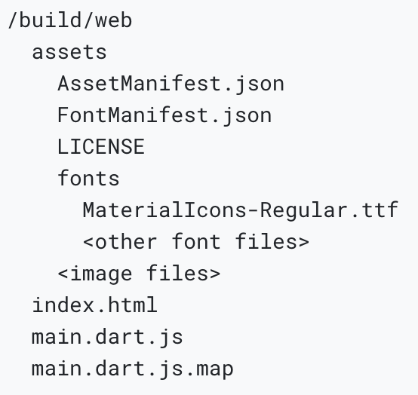
Building the app for release
Build the app for deployment using the flutter build web command. This generates the app, including the assets, and places the files into the /build/web directory of the project.
The release build of a simple app has the following structure:

Slide 47
Launch a web server (for example, python -m SimpleHTTPServer 8000, or by using the dhttpd package), and open the /build/web directory.
Navigate to localhost:8000 in your browser (given the python SimpleHTTPServer example) to view the release version of your app.

Slide 48
Embedding a Flutter app into an HTML page
You can embed a Flutter web app, as you would embed other content, in an iframe tag of an HTML file.
In the following example, replace “URL” with the location of your HTML page:
<iframe src="URL"></iframe>

Slide 49
Deploying to the web
When you are ready to deploy your app, upload the release bundle to Firebase, the cloud, or a similar service. Here are a few possibilities, but there are many others:
Firebase Hosting
GitHub Pages
Google Cloud Hosting

Slide 50
Continuous delivery with Flutter
Notes:
StatelessWidget is used for immutable elements that only rely on the object configuration information
StatefulWidget is used for elements that can dynamically change based on state-changes in the system
Everytime that state changes, setChange() is called by the object

Slide 51
Introduction
Follow continuous delivery best practices with Flutter to make sure your application is delivered to your beta testers and validated on a frequent basis without resorting to manual workflows.
This guide shows how to integrate fastlane, an open-source tool suite, with your existing testing and continuous integration (CI) workflows.

Slide 52
Local setup
It’s recommended that you test the build and deployment process locally before migrating to a cloud-based system.
You could also choose to perform continuous delivery from a local machine.

Slide 53
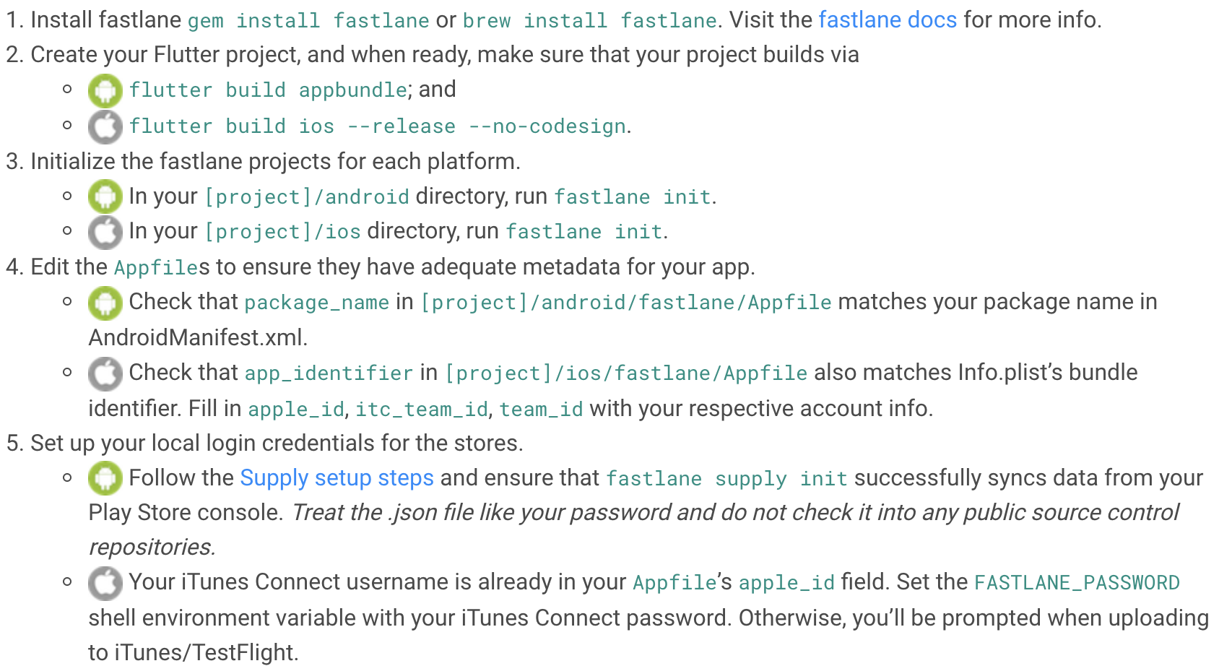

Slide 54
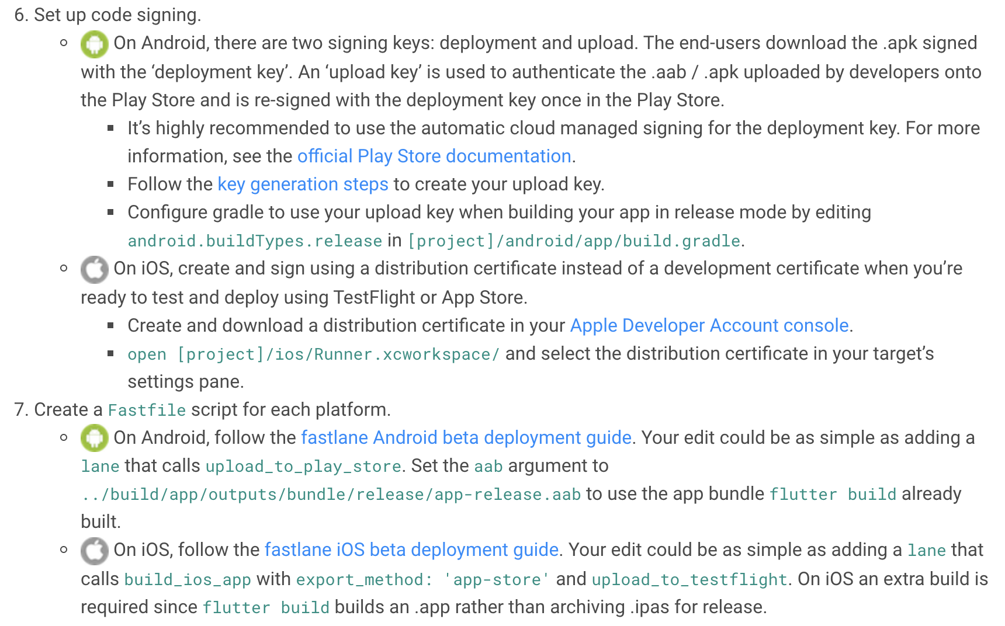

Slide 55
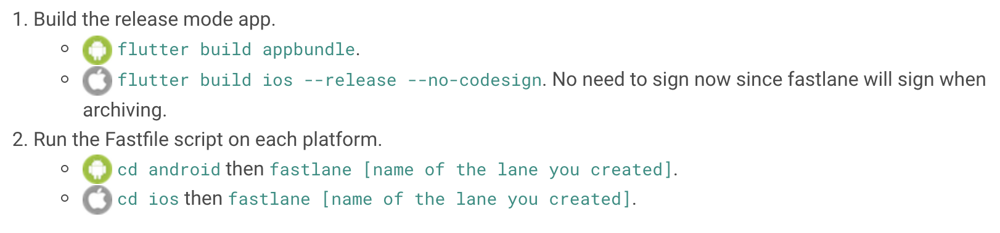
Running deployment locally

Slide 56
Cloud build and deploy setup
First, follow the local setup section described in ‘Local setup’ to make sure the process works before migrating onto a cloud system like Travis.
The main thing to consider is that since cloud instances are ephemeral and untrusted, you won’t be leaving your credentials like your Play Store service account JSON or your iTunes distribution certificate on the server.
Continuous Integration (CI) systems, such as Cirrus generally support encrypted environment variables to store private data.

Slide 57
Take precaution not to re-echo those variable values back onto the console in your test scripts.
Those variables are also not available in pull requests until they’re merged to ensure that malicious actors cannot create a pull request that prints these secrets out.
Be careful with interactions with these secrets in pull requests that you accept and merge.

Slide 58
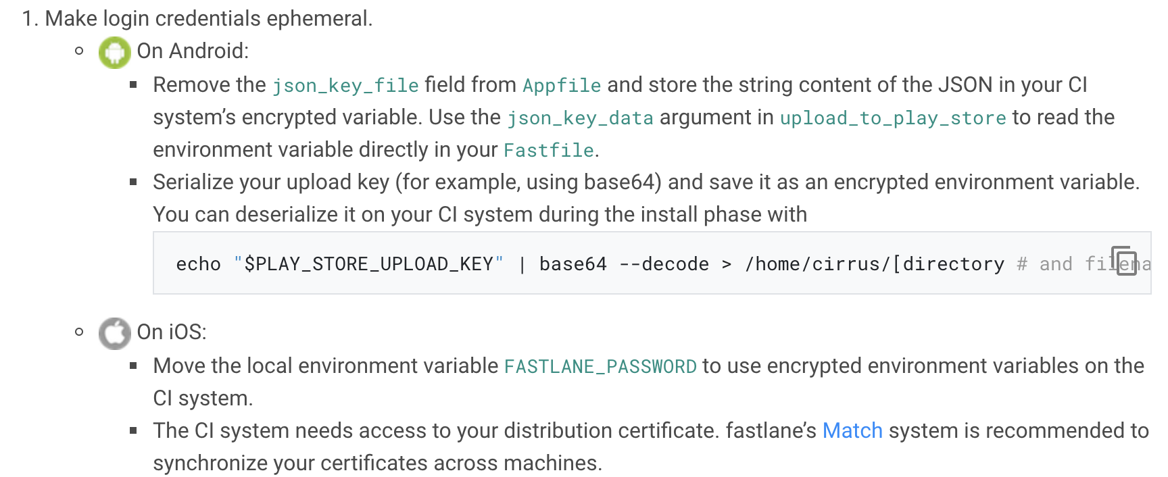

Slide 59
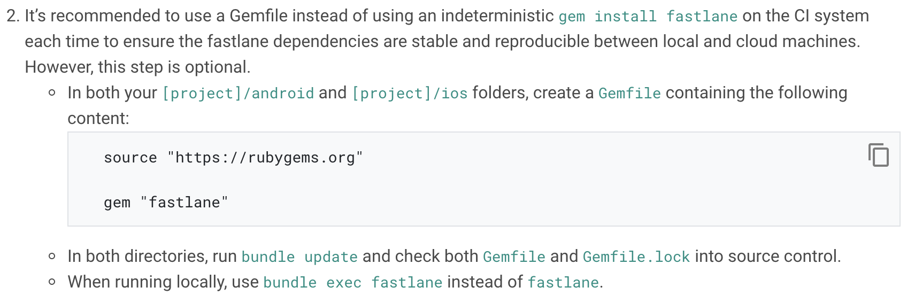

Slide 60
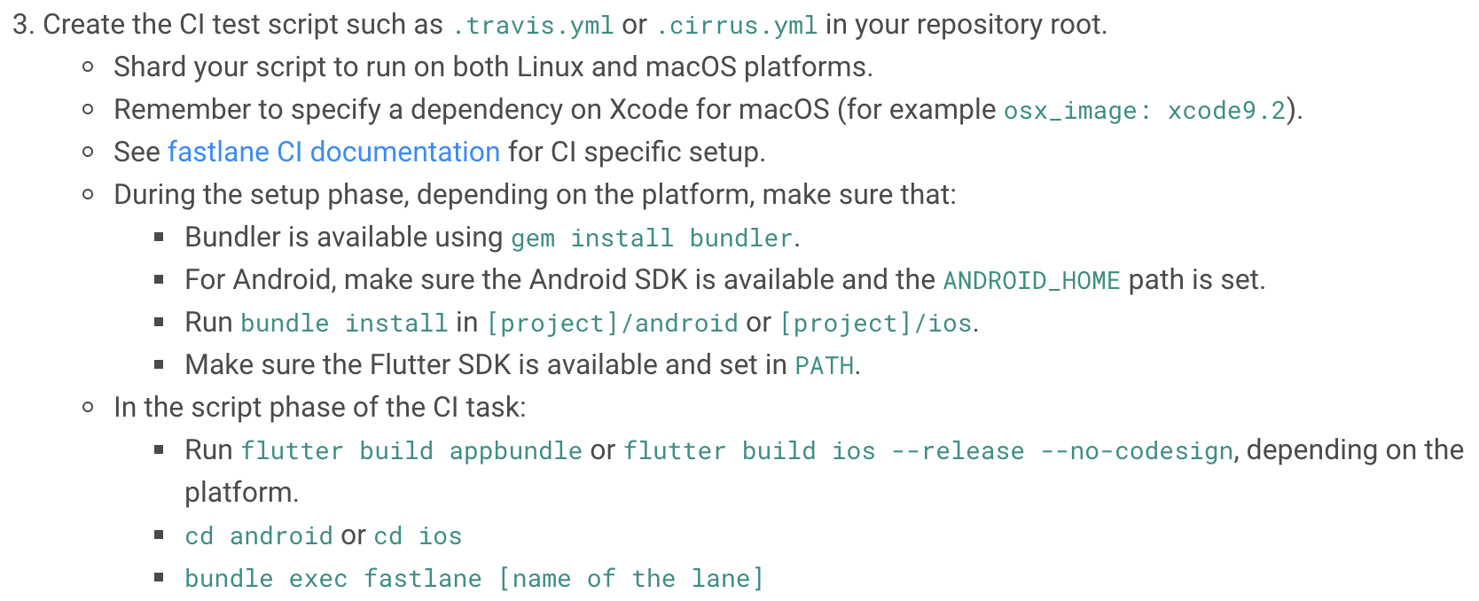

Slide 61
Other services
The following are some other options available to help automate the delivery of your application.
Codemagic CI/CD for Flutter
Flutter CI/CD with Bitrise
GitHub Actions- CI/CD on GitHub Get an Example Project

Slide 62
Thank you!
Wenxuan Shi
College of Software, Nankai University
Email: shiwx@nankai.edu.cn
Wechat: 13920561100

